Slide 1
Venn Diagrams and the Square of Opposition
Mirko Farina
Assistant Professor
Innopolis University
* I do not claim authorship for all texts and pictures in the presentation.

Slide 2
Summary of Previous Lectures
- Elements of Categorical Logic
- Quantity, Quality and Distribution of Categorical Propositions - Exercises
2. Existential Import
3. Venn Diagrams
4. Modern Square of Opposition and Exercises

Slide 3





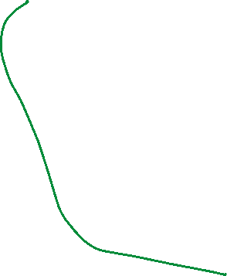














Elements of Categorical Logic

Slide 4


















Quantity, Quality and Distribution

Slide 5




















Exercises Rewrite statements in categorical proposition. Individuate subject, predicate, copula, quantifiers and say which terms (if any) are distributed
1.Conclusions are the statements that are supposed to follow from the premises.
2. Dolphins are swimming between the breakers.
3. Feathers are not heavy.
4. She says what she pleases.
5. Few picnics are not disturbed by ants.

Slide 6




















6. Uncles are never disturbed by aunts.
7. Physicists do not understand philosophy.
8. Not every philosopher likes Humpty Dumpty.
9. A civil right is inalienable if it is a human right.

Slide 7





What logical form?
If you repent, you will go to heaven. You have repented. So you will go to heaven.
If you buy today, I will give you a 10% discount. You have agreed to buy today, so I will reduce the price by 10%. If you are cheating on me, you will be out of the house a lot. You are out of the house a lot, so you must be cheating on me.
If you give a man a gun, he may kill someone. If he has no gun, then he will not kill anyone. If you work hard, you will get a good job. If you do not work hard you will not get a good job

Slide 8
2. Existential Import (applies to A and E claims)
A proposition has Existential Import if it makes a claim of existence
-Not all propositions, categorical or otherwise, necessarily make a claim of existence.
Consider these two examples:
-All Tom Cruise’s movies are hits
-All unicorns are one-horned animals

Slide 9
QUESTIONS:
Should universal propositions [A,E] be interpreted as implying that the things they talk about really exist?
Or should they be interpreted as implying no such thing?
Logicians have taken two different approaches:

Slide 10
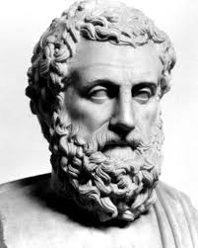

-Aristotle held that universal propositions about existing things do have existential import.
Existential Import = Subject term refers to real things

Slide 11
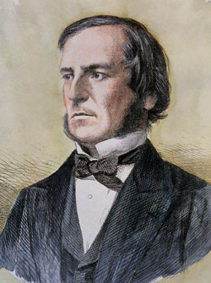

Boole disagreed.
Boole is known primarily for the
development of Boolean algebra
Boole’s work had many fans, including Charles Sanders Pierce and John Venn and Claude Shannon
Boole is an important figure in the history of logic!

Slide 12
Boole = born into a poor family and had to work hard to support it after his father s business folded when he was 16.
He was assistant teacher
then became director of a small boarding school.
At age 29 he published one of his most important papers, where he showed how one can use algebraic methods in solving differential Equations.
A few years later he published his book:The Mathematical
Analysis of Logic, which changed the history of mathematics and logic
He died less than 50 because of a pneumonia, which he caught because he delivered a lecture with wet clothes…

Slide 13




Yes, real particulars, like in Aristotle, do have existential import.
Boole, more nuanced-sophisticated perspective
No, universal statements never imply the existence of the things talked about
A proposition does not make a claim of existence if it refers to a universal

Slide 14




Both Aristotle and Boole agree that unicorns do not have an existential import
Boole, argued that if you make a universal claim , well such a claim does not have existential import
So, he say No, Universals cannot be known

Slide 15

This problem of universals is a very deep problem in philosophy and in logic
Aristotle thought that we could know universals.
How do I know there are threes in the world?
Well through repeated observations (induction) –
problem Russell’s turkey

Slide 16
However, can I really say that all trees are plants? (it is a universal claim). Do I really know that this claim actually implies existence?
The answer Boole gave, was no, it does not - because you can’t have universal knowledge of this
Reason: In order to know that all trees are plants, you would have to go literally throughout the universe of the entire classes (trees and plants) to double check whether elements of these class exist and match to each other.
However, this is impossible..

Slide 17
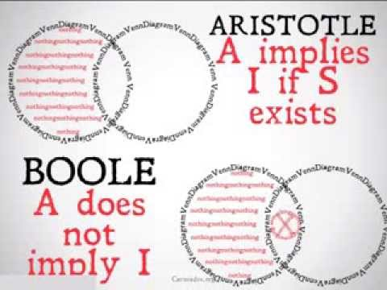
To sum up both agreed that if you are talking about imaginary things (unicorns) there is no existential claim
Both agreed that particulars had existential import
If you are talking about real things: Aristotle though that universals make claim about existence, while Boole said no, they don’t.

Slide 18
INTERMEDIATE SUMMARY
WHAT IS THE EXISTENTIAL IMPORT?
An attribute of propositions that normally assert the existence of objects of
some specified kind.
WHICH STATEMENTS HAVE EXISTENTIAL IMPORT?
Particular propositions (I and O propositions)
always have existential import; thus the proposition “Some dogs are obedient” asserts that there are dogs.
Whether universal propositions (A and E propositions) have existential import is an issue on which the Aristotelian and Boolean interpretations of
propositions differ.

Slide 19
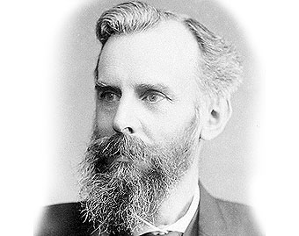
2. Venn Diagrams
J. Venn = English mathematician, logician and philosopher.
1866, Venn published The Logic of Chance.
Venn is also known because he further developed Boole’s theories in the 1881 work Symbolic Logic

Slide 20









Venn Diagrams -
ways of diagramming graphically a categorical proposition.
Rules →
So, what we are allowed to do in Venn Diagrams is either to fill in spaces or to put Xs in.

Slide 21











Take our 4 propositions [A,E,I,O]
A proposition = All S are P

Slide 22





Take E proposition, No S are P

Slide 23











Take I and O proposition

Slide 24
Venn Diagram are helpful because they allow us to test whether or not arguments are valid.
But they are not the only instrument we have to do so!

Slide 25
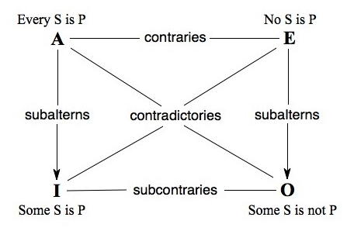
4. Modern Square of Opposition
the square of opposition is a diagram representing the relations between the four basic categorical propositions.
Important: In this lecture we will look at the modern square of opposition, which is simpler and more rudimentary than the original one developed by Aristotle (traditional square of opposition).

Slide 26
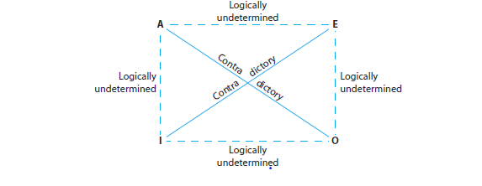





Slide 27
So, we focus on diagonals
As you can see graphically from the diagram diagonals are always contradictory
What is a contradiction?

Slide 28









Example:
A statement.
All S are P all dogs are animals
O statement
Some S are not P some dogs are not animals
It is a contradiction

Slide 29











Take The E and I Statement

Slide 30



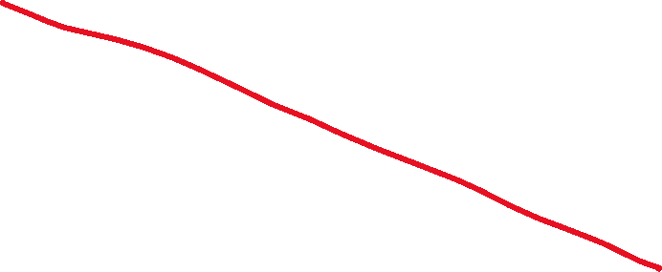








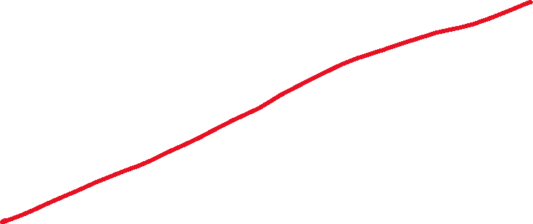

Let us build the Square of Opposition

Slide 31

Next we look at immediate inferences but before we focus on that let’s recall: what is validity?
Validity is when:
if premises are true, conclusion necessarily follow
[an argument is valid if and only if it takes a form that makes it impossible for the premises to be true and the conclusion nevertheless to be false]
Conditional validity (existential import), propositions which Aristotle considered valid, and Boole Invalid
Unconditional validity , propositions on which both Boole and Aristotle agreed
Otherwise invalid/unknown

Slide 32



What is an immediate inference?
An immediate inference is when you take 1 categorical proposition and you conclude something immediately from that proposition.
Some H are not Q
Therefore it is false that all H are Q

Slide 33
How can we test immediate inferences?
STEPS (assume premise is true)
- IDENTIFY EACH PROPOSITION Some H are not Q [O statement] Therefore it is false that All H are Q: F[A statement]
-THINK ABOUT WHETHER THE INFERENCE MAY WORK
-USE THE SQUARE OF OPPOSITION OR THE VENN DIAGRAM TO DETERMINE WHETHER THE INFERENCE IS VALID OR NOT

Slide 34









Exercise
It is false that all A are B

Slide 35


















MORE EXAMPLES….
It is false that all M are C
Therefore, no M are C

Slide 36













All cell phones are wireless devices
Therefore, some cell phones are wireless devices

Slide 37









USE THE MODERN SQUARE OF OPPOSITION TO DETERMINE VALIDITY/INVALIDITY
No Sculptures by Canova are boring creations
Therefore, all sculptures by Canova are boring creations

Slide 38





























It is false than some lunar craters are volcanic formations
Therefore, no lunar crates are volcanic formations

Slide 39



















5. Final Exercise
All trial lawyers are people with stressful jobs
Therefore, some trial lawyers are people with stressful jobs

Slide 40
EXISTENTIAL FALLACY
(Boolean interpretation):
It occurs when you conclude with a claim of existence when you did not have one to start

Slide 41
WHAT DID YOU LEARN TODAY?
- Existential Import (Aristotle VS Boole)
How to construct and use Venn Diagrams
What is a contradiction
What is an immediate inference
How to construct and use the square of opposition
What is the Existential Fallacy

